Slide 1

welcome

Slide 2
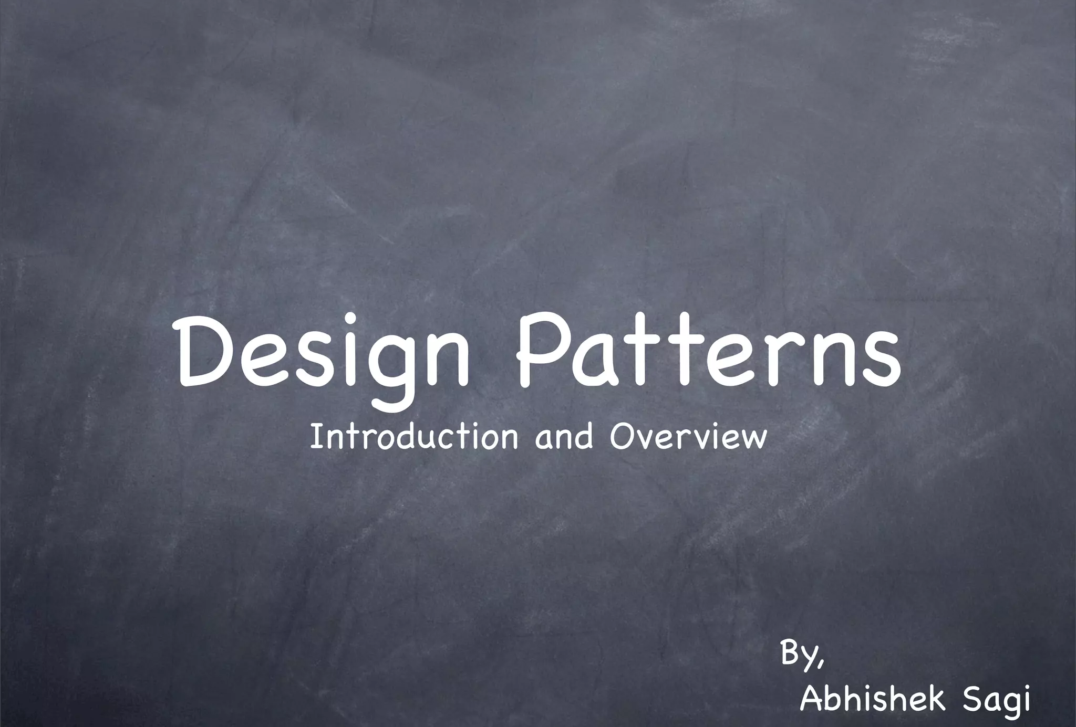

Slide 3
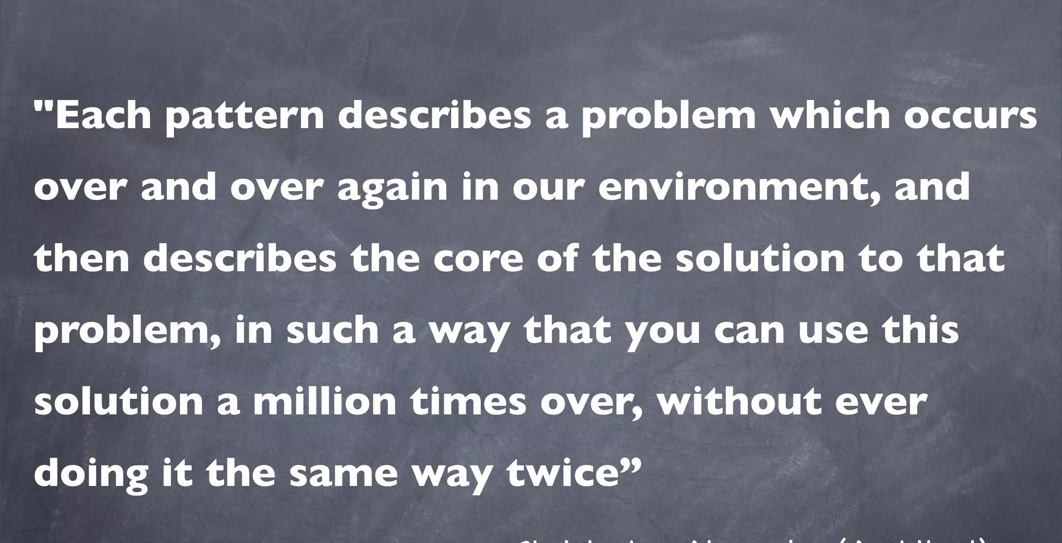

Slide 4
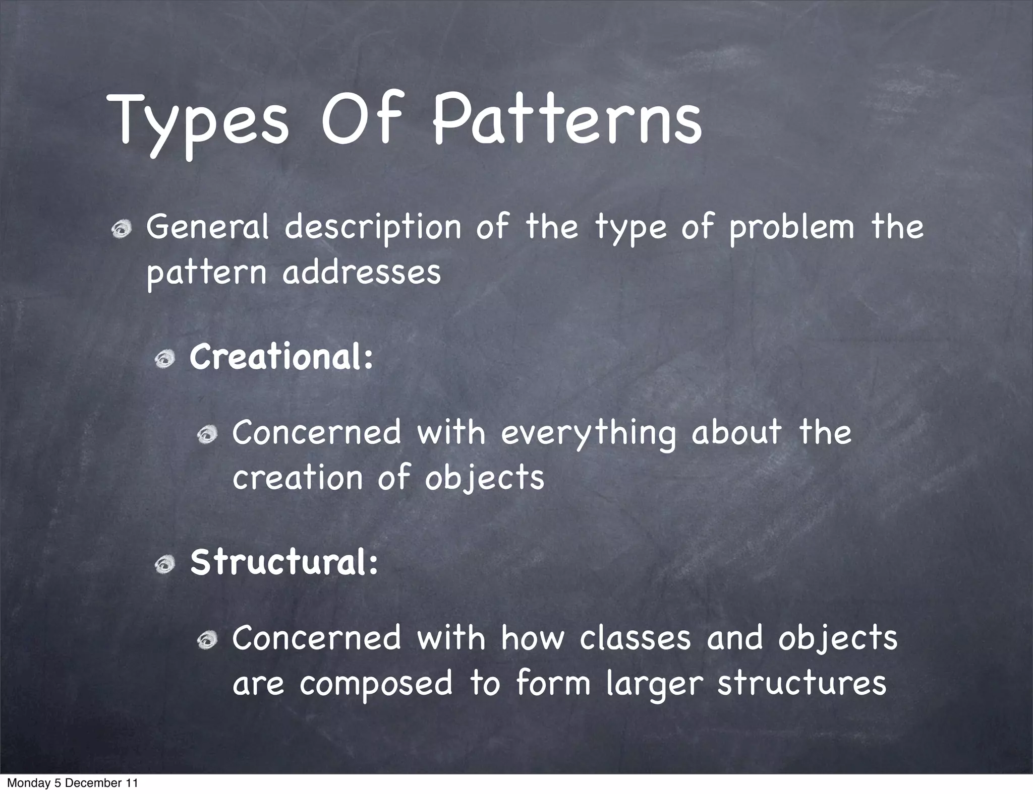

Slide 5
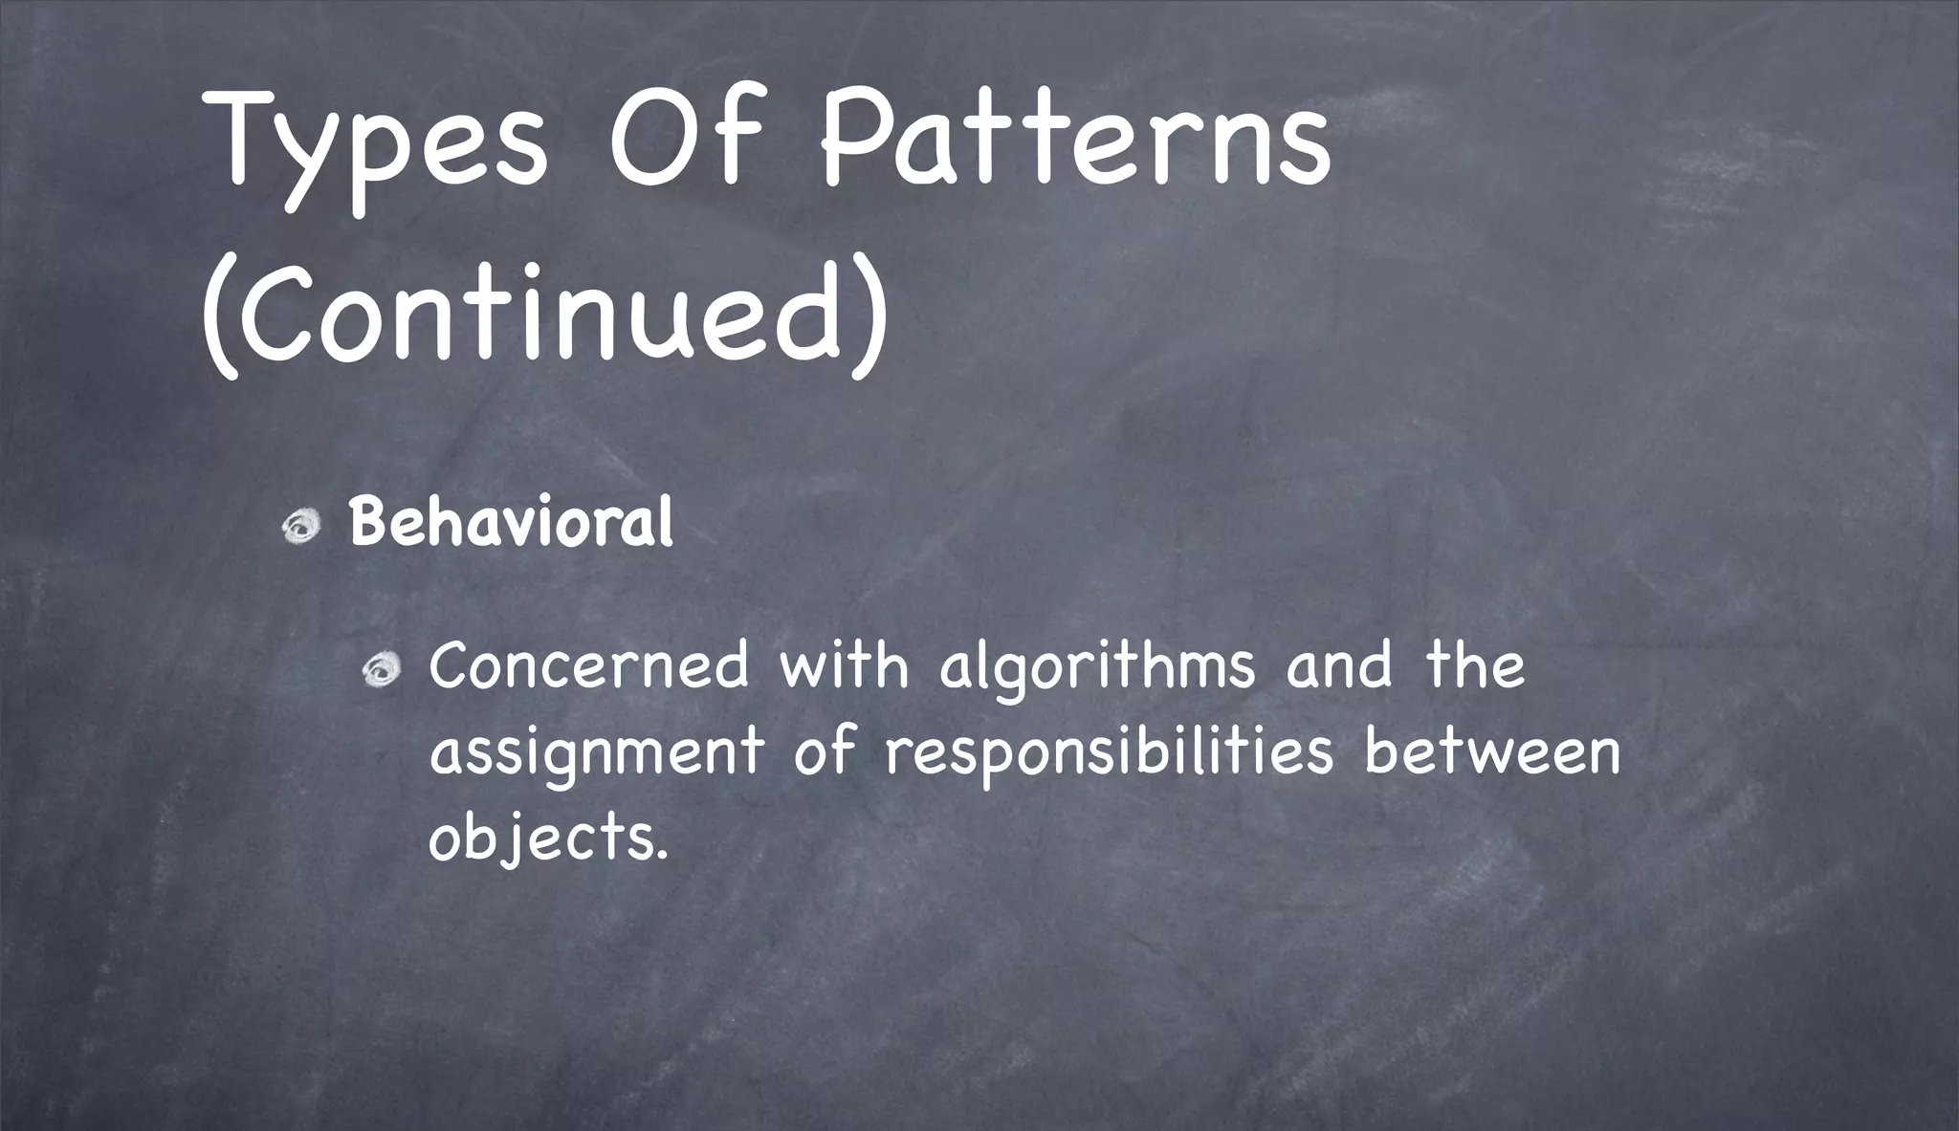

Slide 6
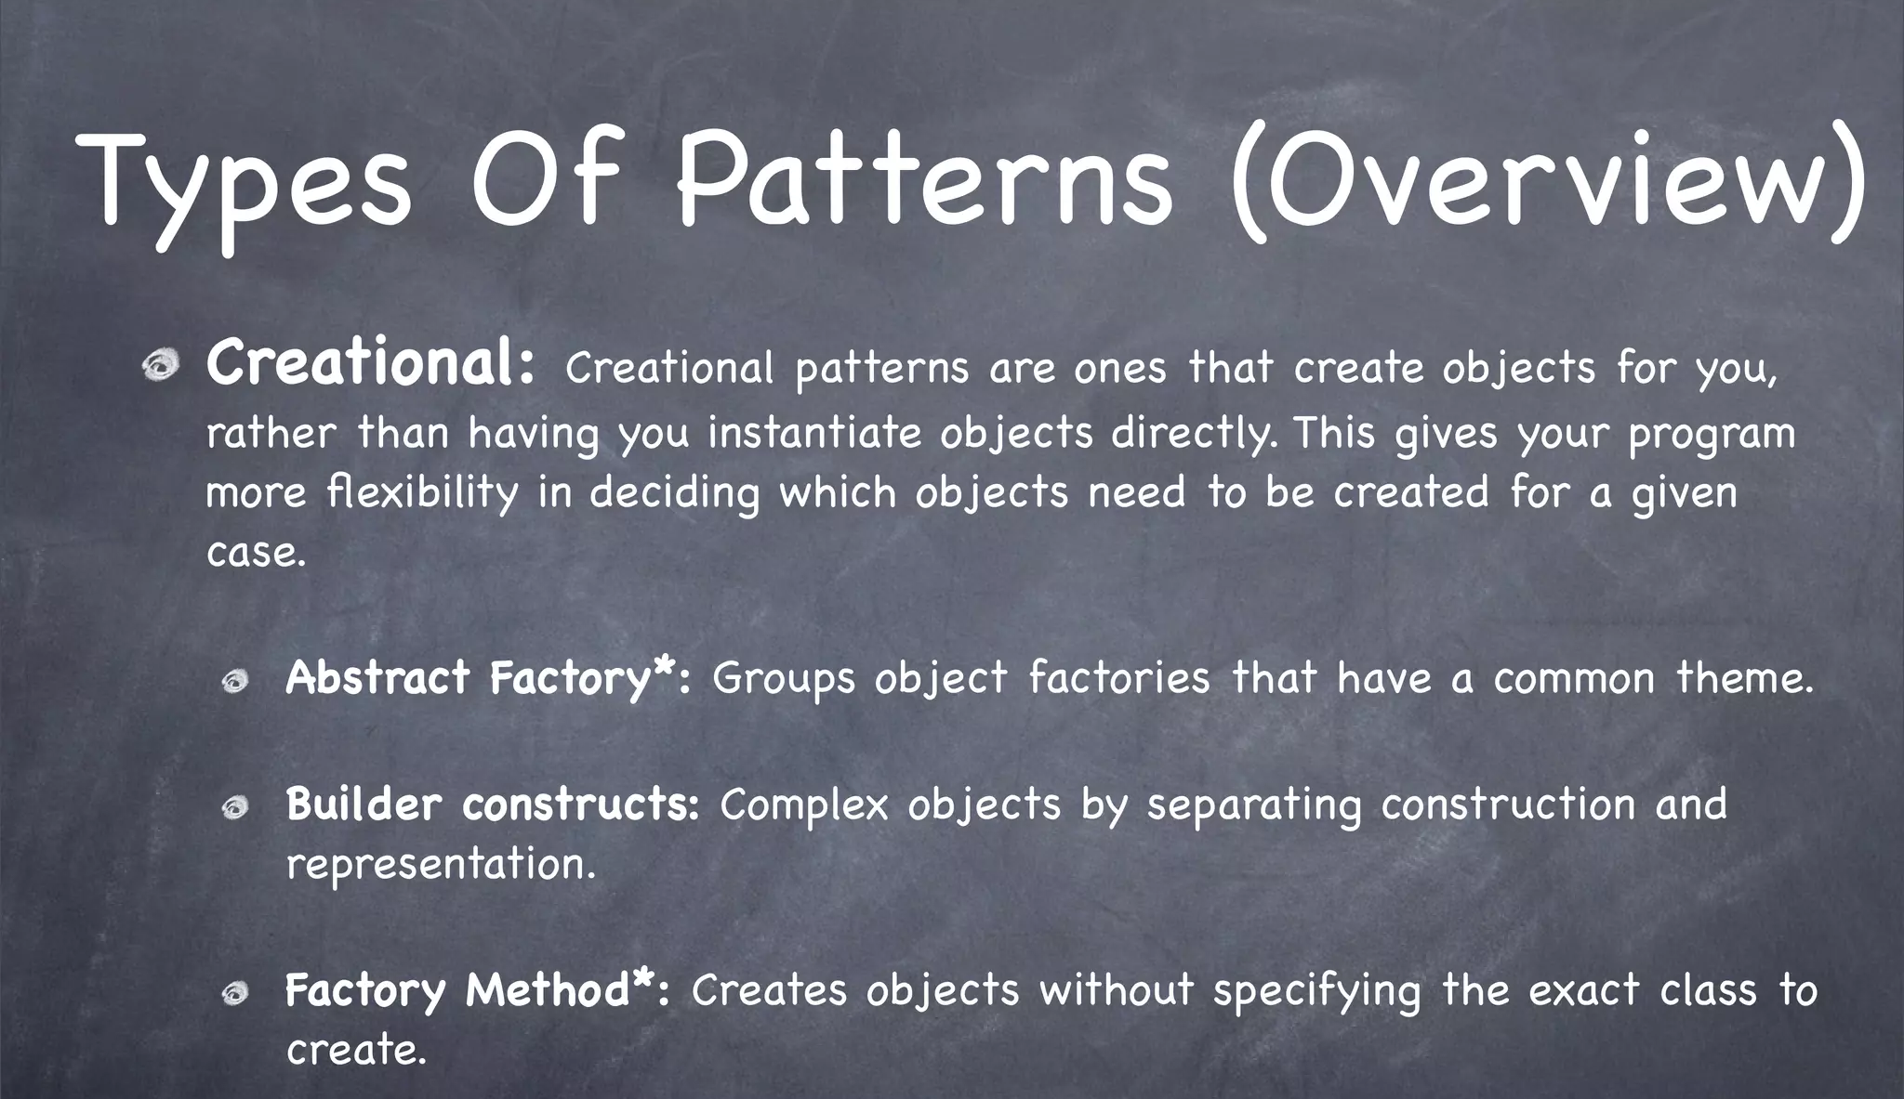

Slide 7
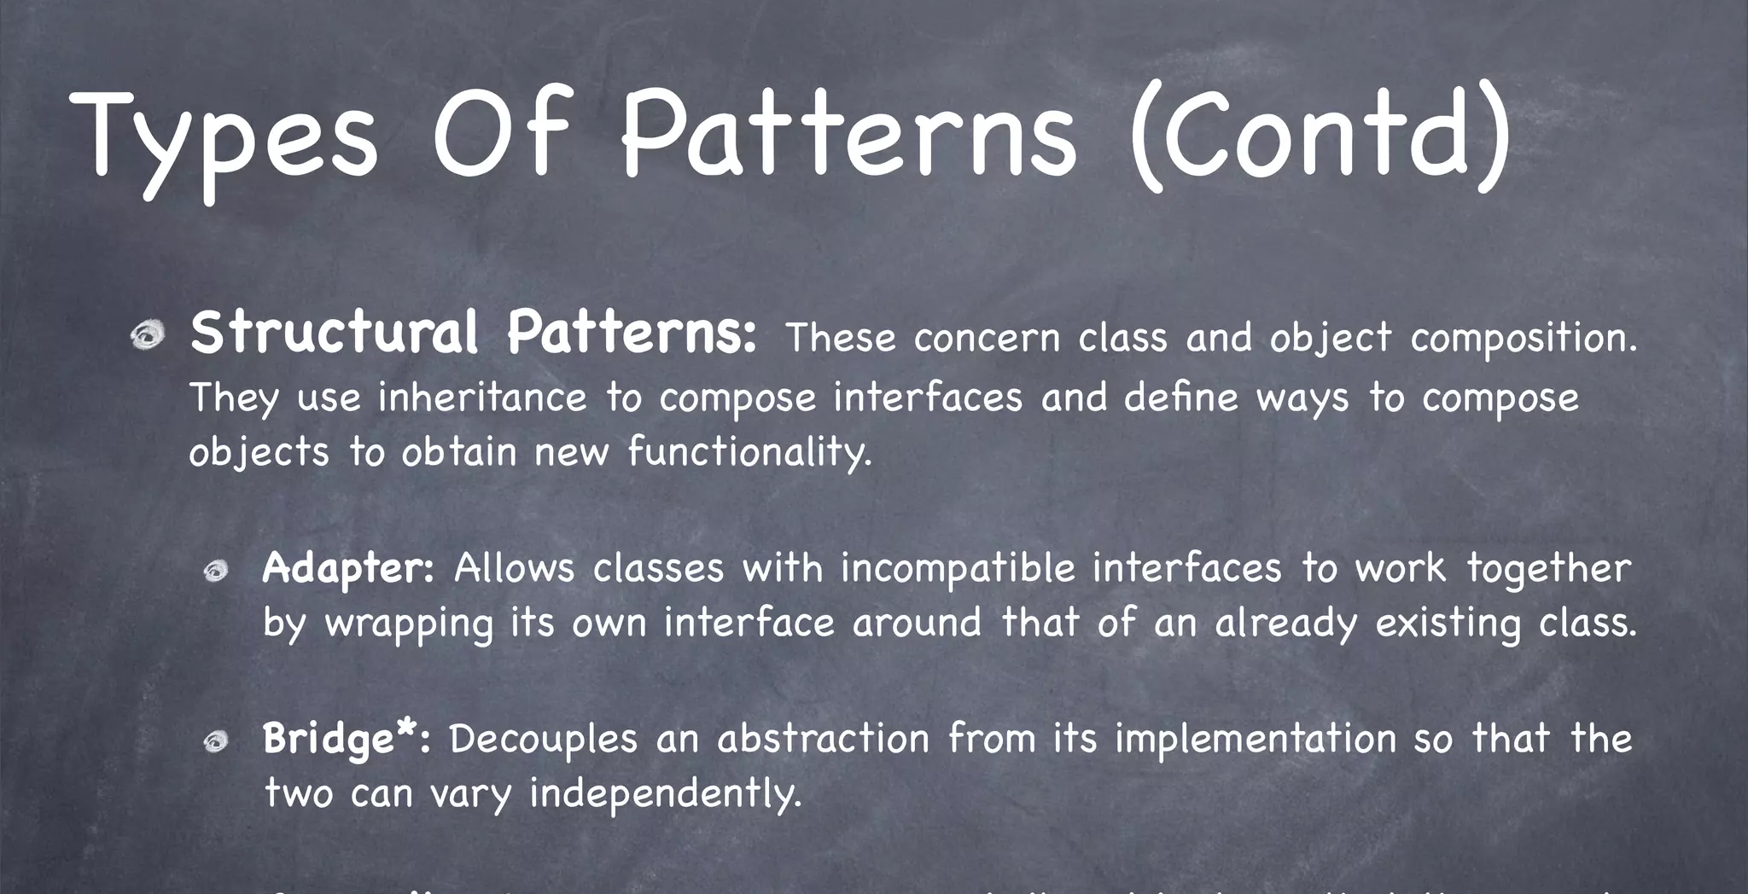

Slide 8
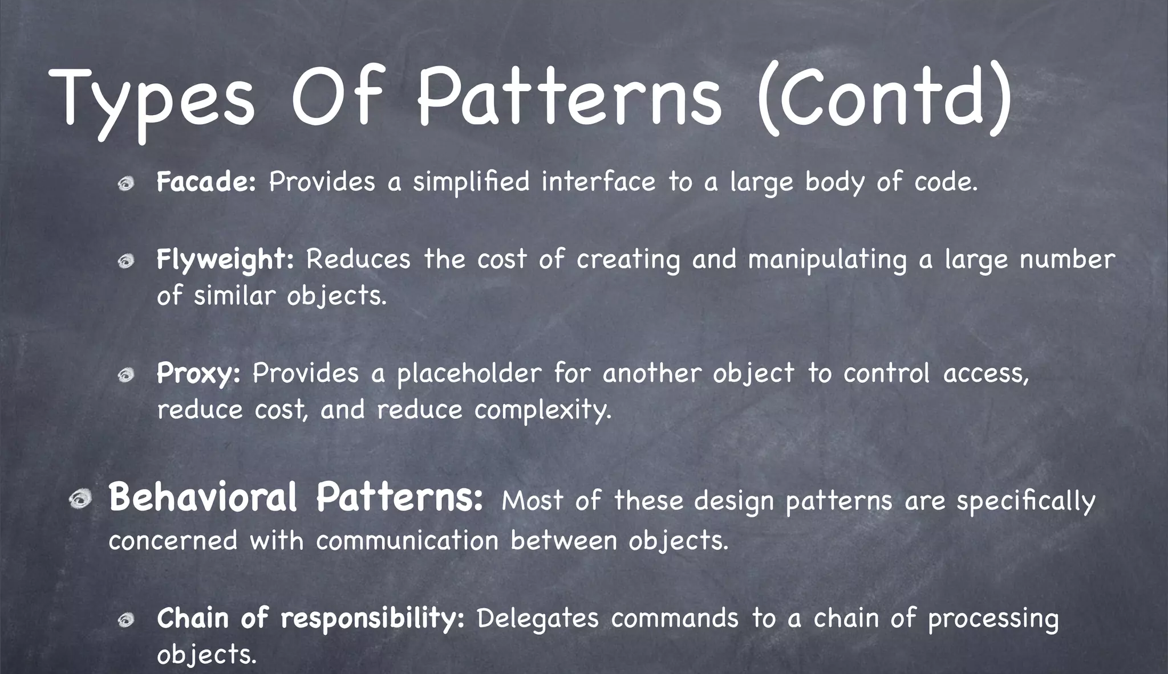

Slide 9

Architecture Patterns
Architecture patterns are high-level design principles and guidelines that provide a structured approach to solving common architectural challenges. They serve as reusable solutions to design problems and help architects and developers create systems that are scalable, maintainable, and efficient.

Slide 10
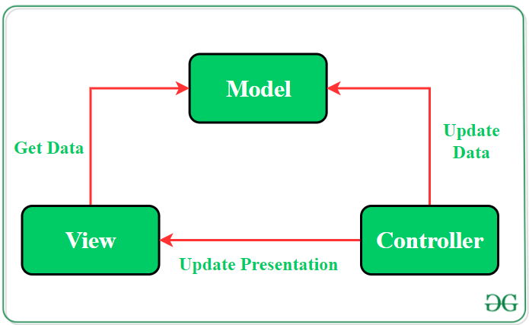
The Model—View—Controller(MVC) Pattern
The MVC pattern suggests splitting the code into 3 components. While creating the class/file of the application, the developer must categorize it into one of the following three layers:
Model: This component stores the application data. It has no knowledge about the interface. The model is responsible for handling the domain logic(real-world business rules) and communication with the database and network layers.
View: It is the UI(User Interface) layer that holds components that are visible on the screen. Moreover, it provides the visualization of the data stored in the Model and offers interaction to the user.
Controller: This component establishes the relationship between the View and the Model. It contains the core application logic and gets informed of the user’s response and updates the Model as per the need.

Slide 11
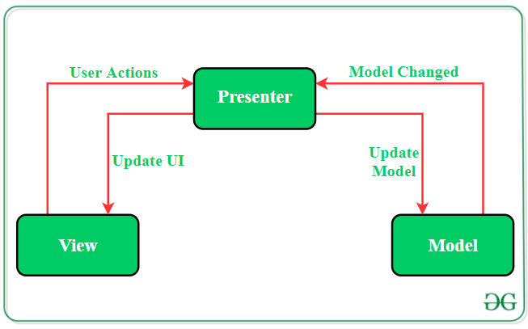
The Model—View—Presenter(MVP) Pattern
MVP pattern overcomes the challenges of MVC and provides an easy way to structure the project codes. The reason why MVP is widely accepted is that it provides modularity, testability, and a more clean and maintainable codebase. It is composed of the following three components:
Model: Layer for storing data. It is responsible for handling the domain logic(real-world business rules) and communication with the database and network layers.
View: UI(User Interface) layer. It provides the visualization of the data and keep a track of the user’s action in order to notify the Presenter.
Presenter: Fetch the data from the model and applies the UI logic to decide what to display. It manages the state of the View and takes actions according to the user’s input notification from the View.

Slide 12
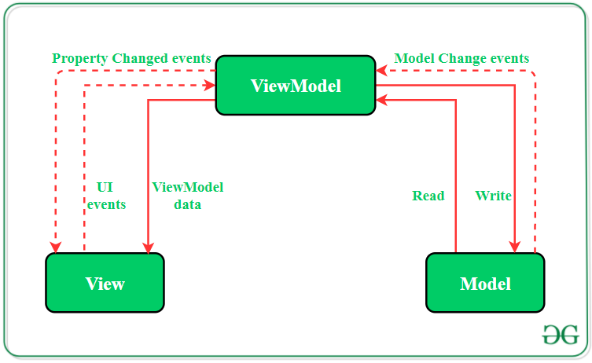
The Model — View — View Model (MVVM) Pattern
MVVM pattern has some similarities with the MVP(Model — View — Presenter) design pattern as the Presenter role is played by the View Model. However, the drawbacks of the MVP pattern has been solved by MVVM. It suggests separating the data presentation logic(Views or UI) from the core business logic part of the application. The separate code layers of MVVM are:
Model: This layer is responsible for the abstraction of the data sources. Model and View Model work together to get and save the data.
View: The purpose of this layer is to inform the View Model about the user’s action. This layer observes the View Model and does not contain any kind of application logic.
View Model: It exposes those data streams which are relevant to the View. Moreover, it servers as a link between the Model and the View.

Slide 13
SOLID Principles
5 Principles of OO Design
Single Responsibility Principle (SRP)
Open-Closed Principle (OCP)
Liskov Substitution Principle (LSP)
Interface Segregation Principle (ISP)
Dependency Inversion Principle (DIP)

Slide 14
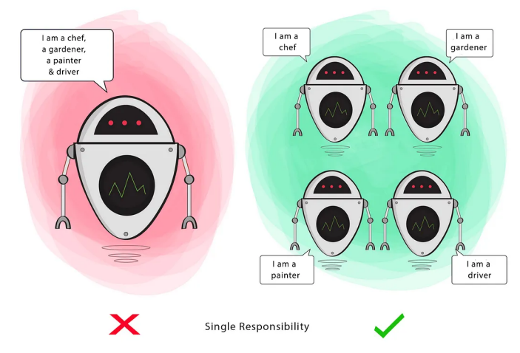
S
Single Responsibility Principle
A class should have a single responsibility
“every class should have only one reason to change”
Principle
A class should do one thing and therefore it should have only a single reason to change.
A module should have one, and only one, reason to change

Slide 15
Open/Closed Principle
O
“software entities (classes, functions, modules, etc.) should be open for extension, but closed for modification.”
Notes:
Abstraction - polymorphism

Slide 16
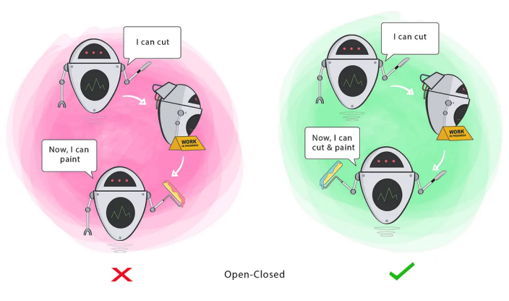
Principle
You should be able to extend a module’s behaviour, without modifying it
We should be able to add new functionality without touching the existing code for the class. This is because whenever we modify the existing code, we are taking the risk of creating potential bugs. So we should avoid touching the tested and reliable (mostly) production code if possible.

Slide 17
Liskov Substitution Principle
L
Subclasses (Derived) classes must be substitutable for
their base classes

Slide 18
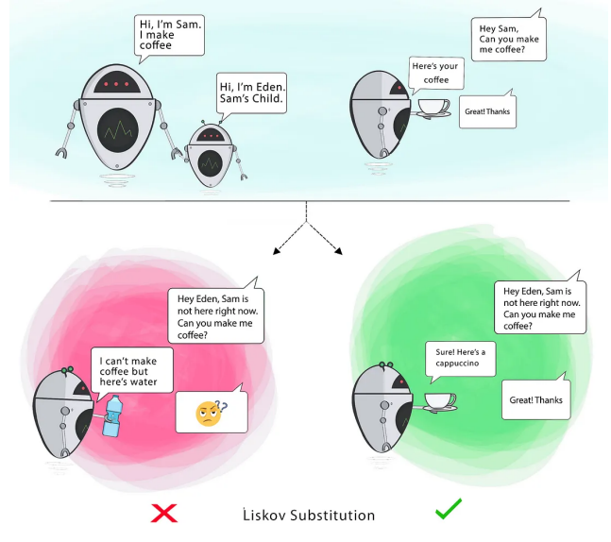
Principle
This means that, given that class B is a subclass of class A, we should be able to pass an object of class B to any method that expects an object of class A and the method should not give any weird output in that case.
Liskov's principle is easy to understand but hard to detect in code.
This principles confirms that our abstraction is correct and helps us get a code that is easy reusable, and class hierarchies that are easily understood. This principle LSP closely is related to OCP. The violation of LSP is actually violation of OCP in theory.

Slide 19
Interface Segregation Principle
I
Clients should not be forced to depend on methods
that they do not use.

Slide 20
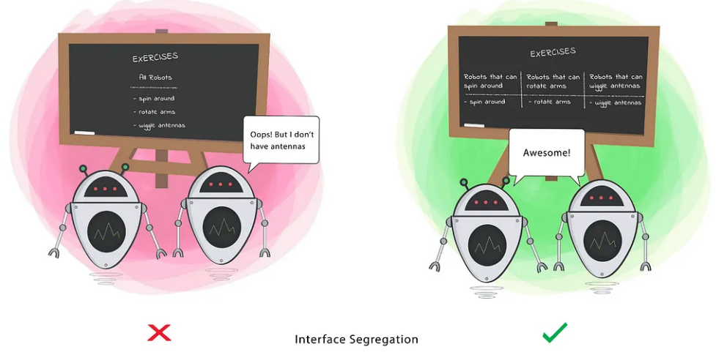
Principle
Segregation means keeping things separated, and the Interface Segregation Principle is about separating the interfaces.
Clients should not be forced to implement a function they do no need.
The interface of a program should be split in a way that the user/client would only have access to the necessary methods related to their needs.

Slide 21
Dependency Inversion Principle
D
Depend on abstractions, not on concretions

Slide 22
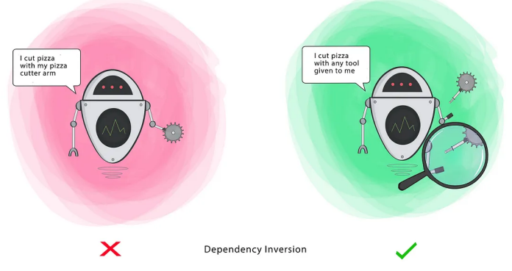
Principle
High-level modules should not depend on low-level modules.
Both should depend on abstractions. Abstractions should not depend upon details.
Details should depend upon abstractions
Notes:
High-Level object: Any object referencing another object (HAS-A relationship).
Low-Level object: The object that is being referenced. (HAS-A relationship in the reverse direction)
Abstractions: Abstract class or an Interface.
Details: Concrete implementations of the Abstractions.

Slide 23
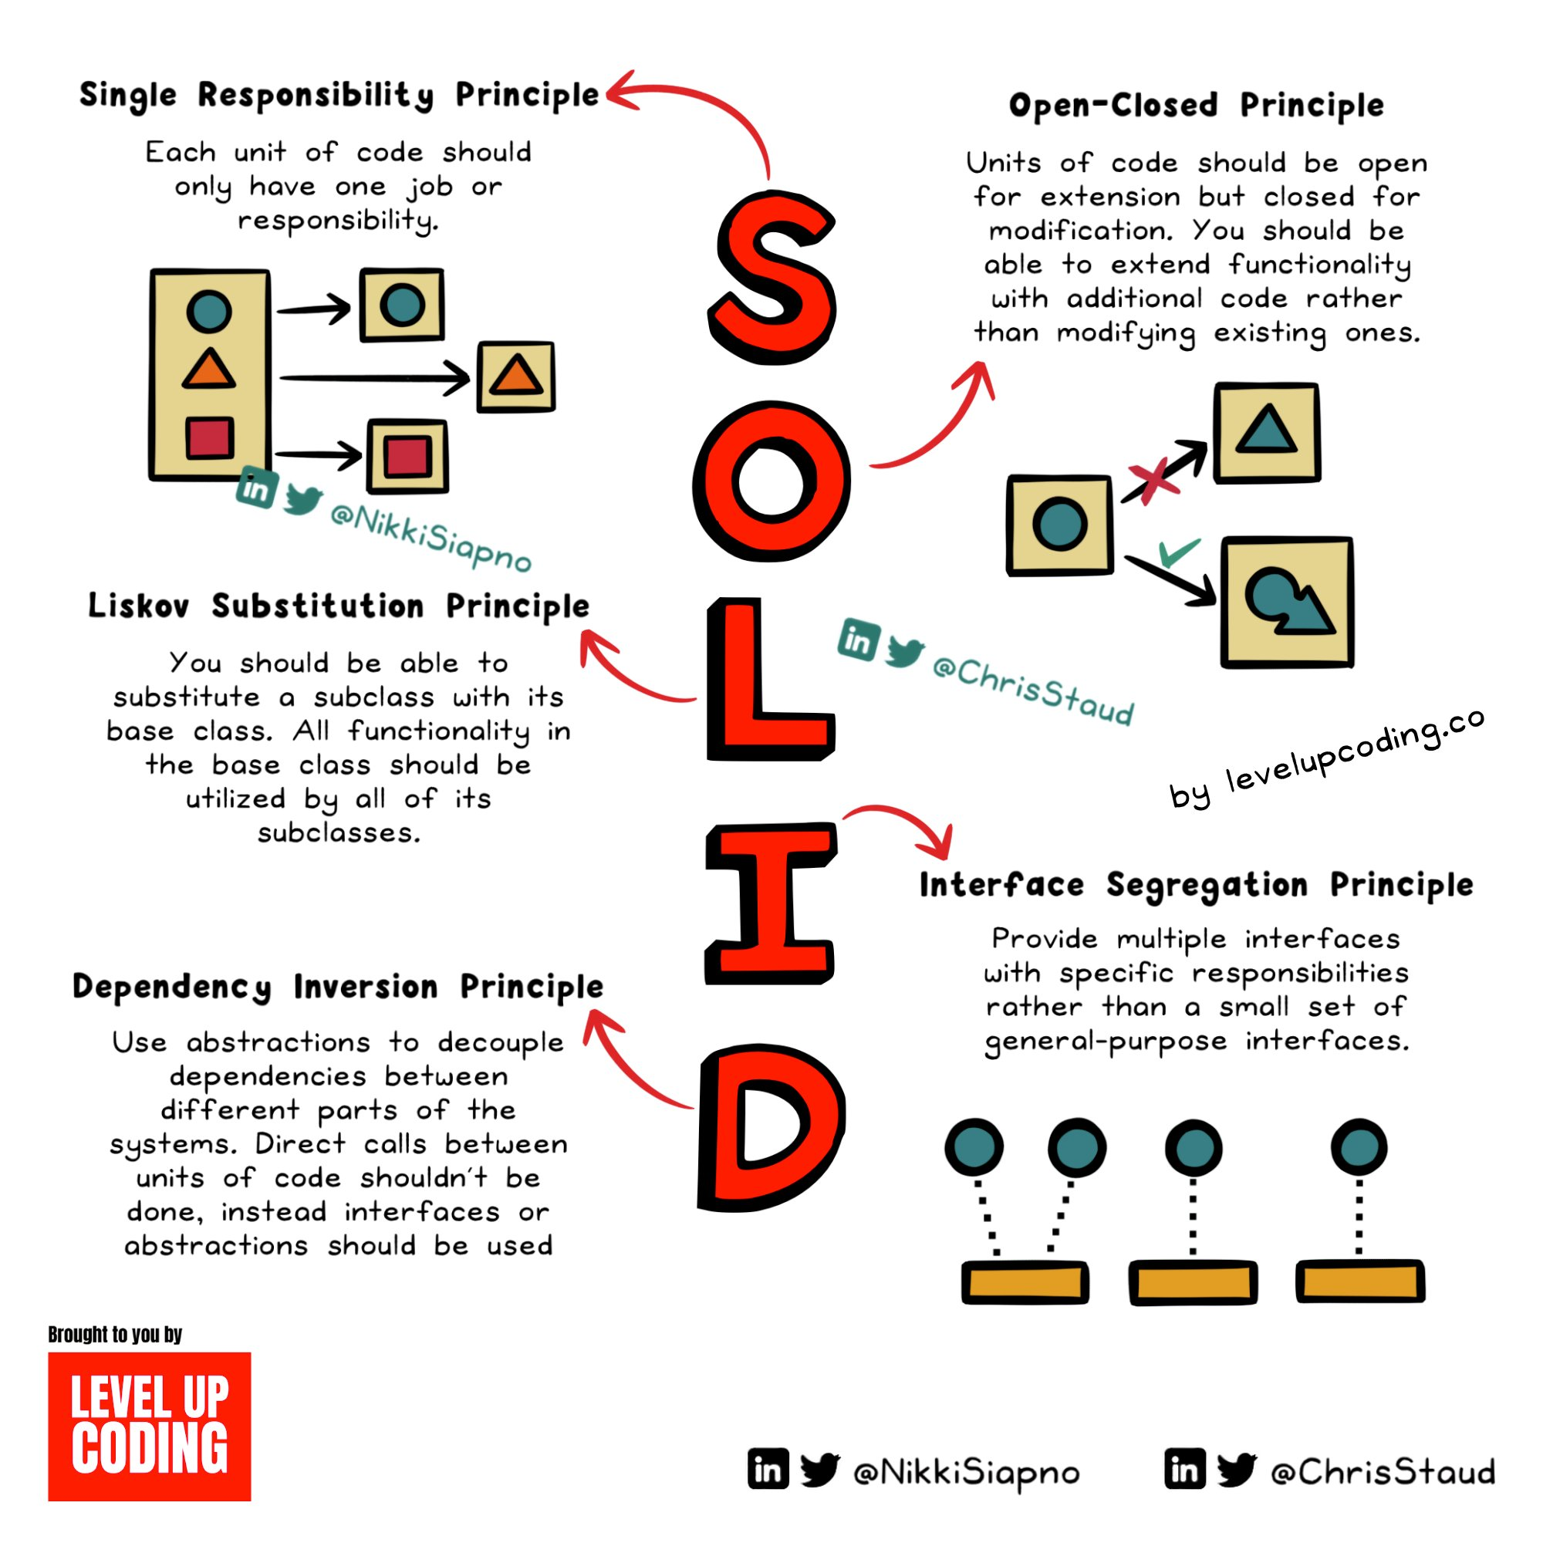
Summary

Slide 24
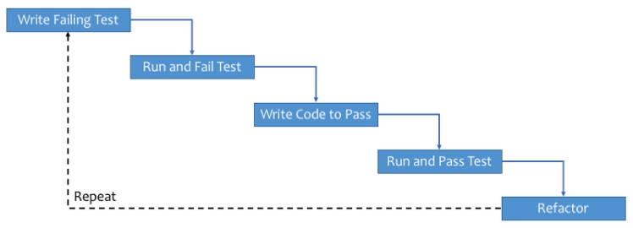
Test Driven Development with python
What Is Test-Driven Development?
TDD is the process of implementing code by writing your tests first, seeing them fail, and then writing the code to make the tests pass. You can then build upon this developed code by appropriately altering your test to expect the outcome of additional functionality, before writing the code to make it pass again.
Syntax for Unit Testing
The main methods that we make use of in unit testing for Python are:
assert: base assert allowing you to write your own assertions
assertEqual(a, b): check a and b are equal
assertNotEqual(a, b): check a and b are not equal
assertIn(a, b): check that a is in the item b
assertNotIn(a, b): check that a is not in the item b
assertFalse(a): check that the value of a is False
assertTrue(a): check that the value of a is True
assertIsInstance(a, TYPE): check that a is of type TYPE
assertRaises(ERROR, a, args): check that when a is called with args, it raises ERROR

Slide 25
The TDD cycle consists of the following steps:
Write a test: Start by writing a test that defines the expected behavior of a specific piece of functionality. This test is often written as a function or method that asserts certain conditions or outcomes.
Run the test: Execute the test to verify that it fails. This is an important step because it ensures that the test is valid and the expected behavior is not already implemented.
Write the code: Implement the minimal amount of code necessary to make the test pass. Focus on solving the specific problem addressed by the test, rather than adding unnecessary functionality.
Run the test again: Execute the test again to check if the code change has successfully made the test pass. If the test fails, iterate and modify the code until the test passes.
Refactor the code: Once the test passes, you can refactor the code to improve its design, structure, or performance while keeping the tests passing. Refactoring ensures that the code remains clean and maintainable.
Repeat the cycle: Move on to the next feature or piece of functionality and repeat the process. Write a new test, run it (which should fail initially), write the code to make it pass, and continue the cycle.

Slide 26

Thank you

